Slide 1
Basic Python programs, functions
Centre For Distributed Computing
Jadavpur University

Slide 2
Python!
Created in 1991 by Guido van Rossum (now at Google)
  Named for Monty Python
Useful as a scripting language
  script: A small program meant for one-time use
  Targeted towards small to medium sized projects
Used by:
  Google, Yahoo!, Youtube
  Many Linux distributions
  Games and apps (e.g. Eve Online)

Slide 3
Installing Python
Windows:
Download Python from http://www.python.org
Install Python.
Run Idle from the Start Menu.
Pycharm community edition can be used for organized project.
Mac OS X:
Python is already installed.
Open a terminal and run python or run Idle from Finder.
Linux:
Chances are you already have Python installed. To check, run python from the terminal.
If not, install from your distribution's package system.
Note: For step by step installation instructions, see the course web site.

Slide 4
Unique Features in Python
There are many features in Python, some of which are discussed below –
1. Easy to code:
Python is a high-level programming language. Python is very easy to learn the language as compared to other languages like C, C#, Javascript, Java, etc. It is very easy to code in python language and anybody can learn python basics in a few hours or days. It is also a developer-friendly language.
2. Free and Open Source:
Python language is freely available at the official website and you can download it from the given download link below click on the Download Python keyword.
Since it is open-source, this means that source code is also available to the public. So you can download it as, use it as well as share it.
3. Object-Oriented Language:
One of the key features of python is Object-Oriented programming. Python supports object-oriented language and concepts of classes, objects encapsulation, etc.
4. GUI Programming Support:
Graphical User interfaces can be made using a module such as PyQt5, PyQt4, wxPython, or Tk in python.
PyQt5 is the most popular option for creating graphical apps with Python.
5. High-Level Language:
Python is a high-level language. When we write programs in python, we do not need to remember the system architecture, nor do we need to manage the memory.
6. Extensible feature:
Python is a Extensible language. We can write us some Python code into C or C++ language and also we can compile that code in C/C++ language.

Slide 5
Unique Features in Python
7. Python is Portable language (Platform Inipendent):
Python language is also a portable language. For example, if we have python code for windows and if we want to run this code on other platforms such as Linux, Unix, and Mac then we do not need to change it, we can run this code on any platform.
8. Python is Integrated language:
Python is also an Integrated language because we can easily integrated python with other languages like c, c++, etc.
9. Interpreted Language:
Python is an Interpreted Language because Python code is executed line by line at a time. like other languages C, C++, Java, etc. there is no need to compile python code this makes it easier to debug our code. The source code of python is converted into an immediate form called bytecode.
10. Large Standard Library
Python has a large standard library which provides a rich set of module and functions so you do not have to write your own code for every single thing. There are many libraries present in python for such as regular expressions, unit-testing, web browsers, etc.
11. Dynamically Typed Language:
Python is a dynamically-typed language. That means the type (for example- int, double, long, etc.) for a variable is decided at run time not in advance because of this feature we don’t need to specify the type of variable.

Slide 6
Important differences between Python 2.x and Python 3.x
Division operator
print function
Unicode
xrange
Error Handling
_future_ module

Slide 7
Interpreted Languages
interpreted
  Not compiled like Java
  Code is written and then directly executed by an interpreter
  Type commands into interpreter and see immediate results
Java:
Code
Compiler
Runtime
Environment
Computer
Python:
Code
Interpreter
Computer

Slide 8
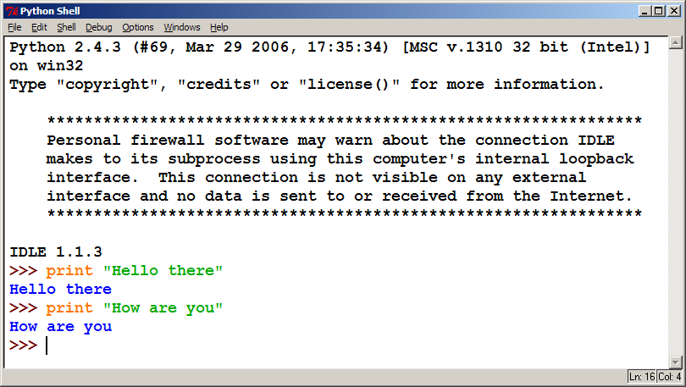
The Python Interpreter
Allows you to type commands one-at-a-time and see results
A great way to explore Python's syntax
  Repeat previous command: Alt+P

Slide 9
Our First Python Program
Python does not have a main method like Java
  The program's main code is just written directly in the file
Python statements do not end with semicolons
hello.py
1 | print("Hello, world!")

Slide 10
The print Statement
  print("text")
  print() (a blank line)
  Escape sequences such as \" are the same as in Java
  Strings can also start/end with '
swallows.py
1 2 3 4 | print("Hello, world!") print() print("Suppose two swallows \"carry\" it together.") print('African or "European" swallows?')

Slide 11
Comments
Syntax:
  # comment text (one line)
swallows2.py
1 2 3 4 5 6 | # Suzy Student, CSE 142, Fall 2097 # This program prints important messages. print("Hello, world!") print() # blank line print("Suppose two swallows \"carry\" it together.") print('African or "European" swallows?')

Slide 12
Functions
Function: Equivalent to a static method in Java.
Syntax:
  def name():
  statement
  statement
  ...
  statement
  Must be declared above the 'main' code
  Statements inside the function must be indented
hello2.py
1 2 3 4 5 6 7 | # Prints a helpful message. def hello(): print("Hello, world!") # main (calls hello twice) hello() hello()

Slide 13
Whitespace Significance
Python uses indentation to indicate blocks, instead of {}
  Makes the code simpler and more readable
  In Java, indenting is optional. In Python, you must indent.
hello3.py
1 2 3 4 5 6 7 8 | # Prints a helpful message. def hello(): print("Hello, world!") print("How are you?") # main (calls hello twice) hello() hello()

Slide 14
Exercise
Rewrite the Figures lecture program in Python. Its output:
  ______
  / \
  / \
  \ /
  \______/
  \ /
  \______/
  +--------+
  ______
  / \
  / \
  | STOP |
  \ /
  \______/
  ______
  / \
  / \
  +--------+

Slide 15
Exercise Solution
def egg():
top()
bottom()
print()
def cup():
bottom()
line()
print()
def stop():
top()
print("| STOP |")
bottom()
print()
def hat():
top()
line()
print()
def top():
print(" ______")
print(" / \\")
print("/ \\")
def bottom():
print("\\ /")
print(" \\______/")
def line():
print("+--------+")
# main
egg()
cup()
stop()
hat()

Slide 16
Expressions
Arithmetic is very similar to other programming language
  Operators: + - * / % (and ** for exponentiation)
  Integers vs. real numbers
>>> 1 + 1
2
>>> 1 + 3 * 4 - 2
11
>>> 7 / 2
3.5
>>> 7.0 / 2
3.5
>>> 10 ** 6
1000000

Slide 17
Variables
Declaring
  no type is written; same syntax as assignment
Operators
  no ++ or -- operators (must manually adjust by 1)
Java | Python
int x = 2; x++; System.out.println(x); x = x * 8; System.out.println(x); double d = 3.2; d = d / 2; System.out.println(d); | x = 2 x = x + 1 print(x) x = x * 8 print(x) d = 3.2 d = d / 2 print(d)

Slide 18
Types
  Variables' types do not need to be declared
  Variables can change types as a program is running
Value | Python type
42 | int
3.14 | float
"ni!" | str

Slide 19
Built-in Data Types
In programming, data type is an important concept.
Variables can store data of different types, and different types can do different things.
Python has the following data types built-in by default, in these categories:
Text Type: | str
Numeric Types: | int, float, complex
Sequence Types: | list, tuple, range
Mapping Type: | dict
Set Types: | set, frozenset
Boolean Type: | bool
Binary Types: | bytes, bytearray, memoryview

Slide 20
Example
Example | Data Type
x = "Hello World" | str
x = 20 | int
x = 20.5 | float
x = 1j | complex
x = ["apple", "banana", "cherry"] | list
x = ("apple", "banana", "cherry") | tuple
x = range(6) | range
x = {"name" : "John", "age" : 36} | dict
x = {"apple", "banana", "cherry"} | set
x = frozenset({"apple", "banana", "cherry"}) | frozenset
x = True | bool
x = b"Hello" | bytes
x = bytearray(5) | bytearray
x = memoryview(bytes(5)) | memoryview

Slide 21
Mutable Vs Immutable Objects
In general, data types in Python can be distinguished based on whether objects of the type are mutable or immutable. The content of objects of immutable types cannot be changed after they are created.
Mutable Objects
byte array
list
set
dict
Immutable Objects
int, float, long, complex
str
tuple
frozen set

Slide 22
Python Data Types
Python´s built-in (or standard) grouped into several classes.
Boolean Types
Numeric Types
Sequences
Sets
Mappings
data types can be

Slide 23
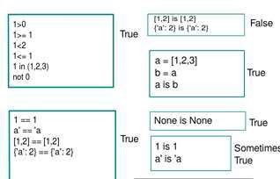
Boolean Types:
The type of the built-in values True and False. Useful in conditional expressions, and anywhere else you want to represent the truth or falsity of some condition. Mostly interchangeable with the integers 1 and 0.
Examples:

Slide 24
Numeric Types:
Python supports four different numerical types :
int (signed integers)
long (long integers [can also be represented in octal and hexadecimal])
float (floating point real values)
complex (complex numbers)

Slide 25
Integers
Examples: 0, 1, 1234, -56
Integers are implemented as C longs
Note: dividing an integer by another integer will return only the integer part of the quotient, e.g. typing 7/2 will yield 3
Long integers
Example: 999999999999999999999L
Must end in either l or L
Can be arbitrarily long

Slide 26
Floating point numbers
Examples: 0., 1.0, 1e10, 3.14e-2, 6.99E4
Implemented as C doubles
Division works normally for floating point numbers: 7./2.
= 3.5
Operations involving both floats and integers willyield floats:
6.4 – 2 = 4.4

Slide 27
Octal constants
Examples: 0177, -01234
Must start with a leading ‘0’
Hex constants
Examples: 0x9ff, 0X7AE
Must start with a leading ‘0x’ or ‘0X’
Complex numbers
Examples: 3+4j, 3.0+4.0j, 2J
Must end in j or J
Typing in the imaginary part first will return the complex number in the order Re+ ImJ

Slide 28
Sequences
There are five sequence types
Strings
Lists
Tuple
Bytearray
Xrange

Slide 29
1. Strings:
Strings in Python are identified as a contiguous set of characters in between quotation marks.
Strings are ordered blocks of text
Strings are enclosed in single or double quotation marks
  Double quotation marks allow the user to extend strings over multiple lines without backslashes, which usually signal the continuation of an expression
Examples: 'abc', “ABC”

Slide 30
Concatenation and repetition
Strings are concatenated with the + sign:
>>> 'abc'+'def' 'abcdef'
Strings are repeated with the * sign:
>>> 'abc'*3 'abcabcabc'

Slide 31
Indexing and Slicing
Python starts indexing at 0. A string s will have indexes running from 0 to len(s)-1 (where len(s) is the length of s) in integer quantities.
s[i] fetches the i^{th} element in s
>>> s = 'string'
>>> s[1] # note that Python considers 't' the first element 't' # of our string s
s[i:j] fetches elements i (inclusive) through j (not inclusive)
>>> s[1:4]
'tri'
s[:j] fetches all elements up to, but not including j
>>> s[:3]
'str'
s[i:] fetches all elements from i onward (inclusive)
>>> s[2:]
'ring'

Slide 32
s[i:j:k] extracts every kth element starting with index i (inlcusive) and ending with index j (not inclusive)
>>> s[0:5:2]
'srn'
Python also supports negative indexes. For example, s[-1] means extract the first element of s from the end (same as s[len(s)-1])
>>> s[-1]
'g'
>>> s[-2]
'n‘
One of Python's coolest features is the string format operator %. This operator is unique to strings and makes up for the pack of having functions from C's printf() family.

Slide 33
Some of the string methods are listed in below:
str.capitalize ( ) str.center(width[, fillchar]) str.count(sub[, start[, end]]) str.encode([encoding[, errors]]) str.decode([decoding[, errors]]) str.endswith(suffix[, start[, end]]) str.find(sub[, start[, end]]) str.isalnum()
str.isalpha() str.isdigit() str.islower() str.isspace()

Slide 34
Sample Program for String Methods
var1='Hello World!' var2='Python Programming' print 'var1[0]: ',var1[0]
print 'var2[0:6]:',var2[0:6]
print 'Updatestring:-',var1[:6]+'Python' print var1*2
print "My name is %s and dob is
%d"%('Python',1990)
# first character capitalized in string str1='guido van rossum'
print str1.capitalize() print str1.center(30,'*‘) sub='s';
print 'str1.count(sub,0):-',str1.count(sub,0) sub='van'
print 'str1.count(sub):-',str1.count(sub) str1=str1.encode('base64','strict')
print 'Encoding string :'+str1
print 'Decode string :'+str1.decode('base64','strict')
str2='Guido van Rossum' suffix='Rossum'
print str2.endswith(suffix) print str2.endswith(suffix,1,17)
# find string in a existed string or not str4='Van'
print str2.find(str4) print str2.find(str4,17) str5='sectokphb10k' print str5.isalnum() str6='kumar pumps' print str6.isalnum() print str4.isalpha() str7='123456789'
print str7.isdigit() print str6.islower() print str2.islower() str8=' '
print str8.isspace()

Slide 35
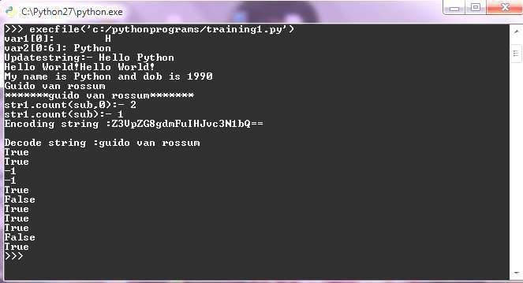
Output for the string methods sample code

Slide 36
2) Lists
Lists are positionally ordered collections of arbitrarily typed objects, and they have no fixed size and they are mutable.
  Lists are contained in square brackets []
  Lists can contain numbers, strings, nested sublists, or nothing
Examples:
L1 = [0,1,2,3],
L2 = ['zero', 'one'],
L3 = [0,1,[2,3],'three',['four,one']],
L4 = []

Slide 37
List indexing works just like string indexing
Lists are mutable: individual elements can be reassigned in place. Moreover, they can grow and shrink in place
Example:
>>> L1 = [0,1,2,3]
>>> L1[0] = 4
>>> L1[0] 4

Slide 38
Basic List Operations
Lists respond to the + and * operators much like strings; they mean concatenation and repetition here too, except that the result is a new list, not a string.
Python Expression | Results | Description
len([1, 2, 3]) | 3 | Length
[1, 2, 3] + [4, 5, 6] | [1, 2, 3, 4, 5, 6] | Concatenation
['Hi!'] * 4 | ['Hi!', 'Hi!', 'Hi!', 'Hi!'] | Repetition
3 in [1, 2, 3] | True | Membership
for x in [1, 2, 3]: print x, | 1 2 3 | Iteration

Slide 39
Some of the List methods are listed in below list.append(obj)
list.count(obj) list.extend(seq) list.index(obj) list.insert(index, obj) list.pop(obj=list[-1]) list.remove(obj) listlist.reverse() list.sort([func])

Slide 40
Sample Code for List Methods
list1=['python','cython','jython'] list1.append('java')
print list1 list1.insert(2,'c++') print list1
list2=['bash','perl','shell','ruby','perl'] list1.extend(list2)
print list1
if 'python' in list1: print 'it is in list1'
if 'perl' in list2: print 'it is in list2'
# reversing the list
list1.reverse() print list1
# sorting the list list2.sort()
print list2
# count the strings in list value=list2.count('perl')
print value
# Locate string index=list1.index("jython") print index,list1[index]

Slide 41
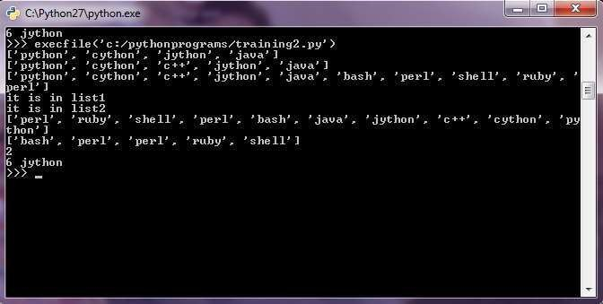
Output for the list methods sample code

Slide 42
3) Tuple:
A tuple is a sequence of immutable Python objects. Tuples are sequences, just like lists.
The only difference is that tuples can't be changed i.e., tuples are immutable and tuples use parentheses and lists use square brackets.
Tuples are contained in parentheses ()
Tuples can contain numbers, strings, nested sub-tuples, or nothing Examples:
t1 = (0,1,2,3)
t2 = ('zero', 'one')
t3 = (0,1,(2,3),'three',('four,one'))
t4 = ()

Slide 43


Basic Tuple Operations
Tuples respond to the + and * operators much like strings; they mean concatenation and repetition here too, except that the result is a new tuple, not a string.
Python Expression | Results | Description
len((1, 2, 3)) | 3 | Length
(1, 2, 3) + (4, 5, 6) | (1, 2, 3, 4, 5, 6) | Concatenation
['Hi!'] * 4 | ('Hi!', 'Hi!', 'Hi!', 'Hi!') | Repetition
3 in (1, 2, 3) | True | Membership
for x in (1, 2, 3): print x, | 1 2 3 | Iteration

Slide 44
4) Bytearray:
bytearray([source[, encoding[, errors]]])
Return a new array of bytes. The bytearray type is a mutable sequence of integers in the range 0 <= x < 256. The optional source parameter can be used to initialize the array in a few different ways:
If it is a string, you must also give the encoding (and
optionally, errors) parameters; bytearray() then converts the string to bytes using str.encode()
If it is an integer, the array will have that size and will be initialized with null bytes.
If it is an object conforming to the buffer interface, a read-only buffer of the object will be used to initialize the bytes array.
If it is an iterable, it must be an iterable of integers in the
range 0 <= x < 256, which are used as the initial contents of the array.
Without an argument, an array of size 0 is created.

Slide 45
5) Xrange:
The xrange type is an immutable sequence which is commonly used for looping. The advantage of the xrange type is that an xrange object will always take the same amount of memory, no matter the size of the range it represents. There are no consistent performance advantages.
XRange objects have very little behavior: they only support indexing, iteration, and the len( ) function.

Slide 46
Sets
The sets module
provides unordered
classes for collections of
The sets module provides classes for constructing and manipulating unordered collections of unique elements.
Common uses include membership testing, removing duplicates from a sequence, and computing standard math operations on sets such as intersection, union, difference, and symmetric difference.
Curly braces or the set() function can be used to create sets.
constructing and manipulating
removing duplicates

Slide 47


Sets Operations
Operation | Equivalent | Result
len(s) |  | cardinality of set s
x in s |  | test x for membership in s
x not in s |  | test x for non-membership in s
s.issubset(t) | s <= t | test whether every element in s is in t
s.issuperset(t) | s >= t | test whether every element in t is in s
s.union(t) | s | t | new set with elements from both s and t
s.intersection(t) | s & t | new set with elements common to s and t
s.difference(t) | s - t | new set with elements in s but not in t
s.symmetric_difference(t) | s ^ t | new set with elements in either s or t but not both
s.copy() |  | new set with a shallow copy of s

Slide 48


Operation | Equivalent | Result
s.update(t) | s |= t | return set s with elements added from t
s.intersection_update(t) | s &= t | return set s keeping only elements also found in t
s.difference_update(t) | s -= t | return set s after removing elements found in t
s.symmetric_difference_update(t) | s ^= t | return set s with elements from s or t but not both
s.add(x) |  | add element x to set s
s.remove(x) |  | remove x from set s; raises KeyError if not present
s.discard(x) |  | removes x from set s if present
s.pop() |  | remove and return an arbitrary element from s; raises KeyError if empty
s.clear() |  | remove all elements from set s

Slide 49
Mapping Type
A mapping object maps hashable values to arbitrary objects. Mappings are mutable objects. There is currently only one standard mapping type, the dictionary.
Dictionaries consist of pairs (called items) of keys and their corresponding values.
Dictionaries can be created by placing a comma-separated list of key: value pairs within curly braces
Keys are unique within a dictionary while values may not be. The values of a dictionary can be of any type, but the keys must be of an immutable data type such as strings, numbers, or tuples.
Example:
d={'python':1990,'cython':1995,'jython':2000}

Slide 50
Some of the dictionary methods listed in below
len( dict ) dict.copy( ) dict.items( ) dict.keys( ) dict.values( ) dict.has_key(‘key’) viewitems( ) viewkeys( ) viewvalues( )

Slide 51
Sample code for dictionary methods
dict = {'Language': 'Python', 'Founder': 'Guido Van Rossum'} print dict
print "Length of dictionary : %d" % len(dict) copydict = dict.copy()
print "New Dictionary : %s" % str(copydict) print "Items in dictionary: %s" % dict.items() print "Keys in dictionary: %s" % dict.keys() print "Vales in Dictionary: %s" % dict.values()
print "Key in dictionary or not: %s" % dict.has_key('Language') print "Key in dictionary or not: %s" % dict.has_key('Year')

Slide 52
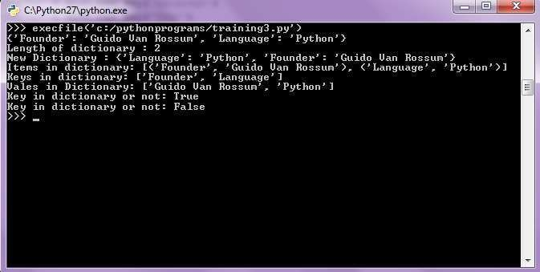
Output for the dictionary sample code

Slide 53
String Multiplication
Python strings can be multiplied by an integer.
  The result is many copies of the string concatenated together.
>>> "hello" * 3
"hellohellohello"
>>> print(10 * "yo ")
yo yo yo yo yo yo yo yo yo yo
>>> print(2 * 3 * "4")
444444

Slide 54
String Concatenation
Integers and strings cannot be concatenated in Python.
  Workarounds:
  str(value) - converts a value into a string
  print(expr, expr) - prints two items on the same line
>>> x = 4
>>> print("Thou shalt not count to " + x + ".")
TypeError: cannot concatenate 'str' and 'int' objects
>>> print("Thou shalt not count to " + str(x) + ".")
Thou shalt not count to 4.
>>> print(x + 1, "is out of the question.")
5 is out of the question.

Slide 55
The for Loop
  for name in range(max):
  statements
  Repeats for values 0 (inclusive) to max (exclusive)
>>> for i in range(5):
... print(i)
0
1
2
3
4

Slide 56
for Loop Variations
  for name in range(min, max):
  statements
  for name in range(min, max, step):
  statements
  Can specify a minimum other than 0, and a step other than 1
>>> for i in range(2, 6):
... print(i)
2
3
4
5
>>> for i in range(15, 0, -5):
... print(i)
15
10
5

Slide 57
Nested Loops
Nested loops are often replaced by string * and +
  ....1
  ...2
  ..3
  .4
  5
Java
1 2 3 4 5 6 | for (int line = 1; line <= 5; line++) { for (int j = 1; j <= (5 - line); j++) { System.out.print("."); } System.out.println(line); }
Python
1 2 | for line in range(1, 6): print((5 - line) * "." + str(line))

Slide 58
Exercise
Rewrite the Mirror lecture program in Python. Its output:
  #================#
  | <><> |
  | <>....<> |
  | <>........<> |
  |<>............<>|
  |<>............<>|
  | <>........<> |
  | <>....<> |
  | <><> |
  #================#

Slide 59
Exercise Solution
def bar():
print "#" + 16 * "=" + "#"
def top():
for line in range(1, 5):
# split a long line by ending it with \
print "|" + (-2 * line + 8) * " " + \
"<>" + (4 * line - 4) * "." + "<>" + \
(-2 * line + 8) * " " + "|"
def bottom():
for line in range(4, 0, -1):
print "|" + (-2 * line + 8) * " " + \
"<>" + (4 * line - 4) * "." + "<>" + \
(-2 * line + 8) * " " + "|"
# main
bar()
top()
bottom()
bar()

Slide 60
Concatenating Ranges
Ranges can be concatenated with +
  Can be used to loop over a disjoint range of numbers
>>> range(1, 5) + range(10, 15)
[1, 2, 3, 4, 10, 11, 12, 13, 14]
>>> for i in range(4) + range(10, 7, -1):
... print(i)
0
1
2
3
10
9
8

Slide 61
Exercise Solution 2
def bar():
print "#" + 16 * "=" + "#"
def mirror():
for line in range(1, 5) + range(4, 0, -1):
print "|" + (-2 * line + 8) * " " + \
"<>" + (4 * line - 4) * "." + "<>" + \
(-2 * line + 8) * " " + "|"
# main
bar()
mirror()
bar()

Slide 62
Constants
Python doesn't really have constants.
  Instead, declare a "global" variable at the top of your code.
  All methods will be able to use this value.
constant.py
1 2 3 4 5 6 7 8 9 10 11 12 13 | MAX_VALUE = 3 def printTop(): for i in range(MAX_VALUE): for j in range(i): print(j) print() def printBottom(): for i in range(MAX_VALUE, 0, -1): for j in range(i, 0, -1): print(MAX_VALUE) print()

Slide 63
Taking input in Python
Developers often have a need to interact with users, either to get data or to provide some sort of result. Most programs today use a dialog box as a way of asking the user to provide some type of input. While Python provides us with two inbuilt functions to read the input from the keyboard.
input ( prompt )
raw_input ( prompt )
input ( ) : This function first takes the input from the user and then evaluates the expression, which means Python automatically identifies whether user entered a string or a number or list. If the input provided is not correct then either syntax error or exception is raised by python. For example –
1.
2.
val = input("Enter your value: ")
print(val)
num = input ("Enter number :")
print(num)
name1 = input("Enter name : ")
print(name1)
# Printing type of input value
print ("type of number", type(num))
print ("type of name", type(name1))

Slide 64
Introduction to Object Oriented Programming in Python

Slide 65
Why OOP?
Often we describe real-life objects in code (which is easier with OOP),
Code get’s more manageable,
With OPP, it is easy to reuse previously written code,
Every bigger real-life project will be written in OOP.

Slide 66
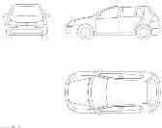



Object oriented programming
Object in Python is a representation of a person, a place, a bank account, a car, or any item that the program should handle.
Object Oriented Programming Recipe:
  (1) define classes (these are descriptions)
  (2) make object instances out of classes.
Class Car
Car instances

Slide 67
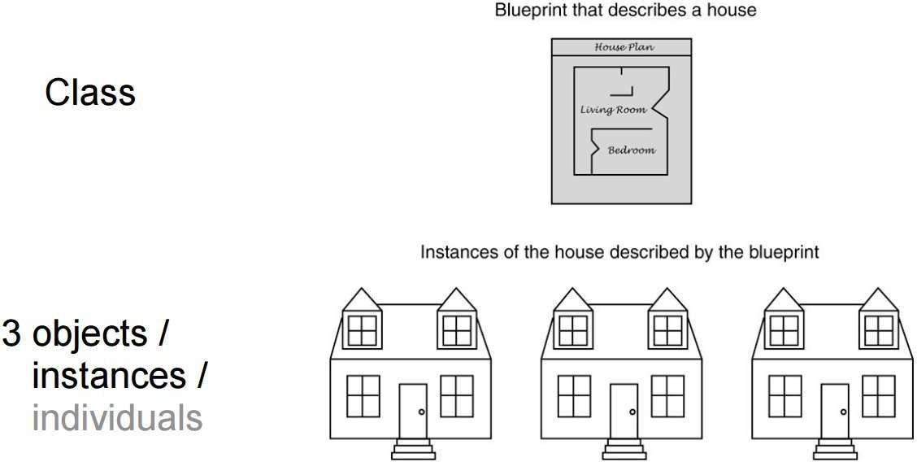

Slide 68
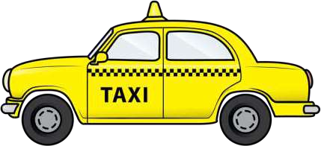
OOP with a Taxi Example
To learn OOP, we will use an example of a Taxi.

Slide 69
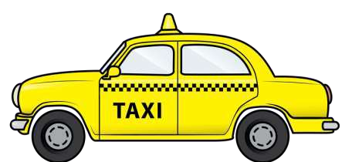
Example Object - Taxi
Every object has two main components: Data (the attributes about it) Behavior (the methods)
DATA
DriverName
OnDuty
NumPassenger
Cities
BEHAVIOR
PickUpPassenger
DropOffPassenger
SetDriverName
GetDriverName

Slide 70
Taxi
DriverName: string OnDuty: Boolean NumPassenger: int Cities:list
PickUpPassenger():int DropOffPassenger(): int SetDriverName(string) GetDriverName:string

Slide 71
Creating a simple class in Python
In a class, we describe (1) how the object will look like, and (2) what behavior it will have.
Classes are the blueprints for a new data type in your program!
A class should have at minimum*:
  A name (e.g. Class Taxi)
  A constructor method (that describes how to create a new object,
init )

Slide 72
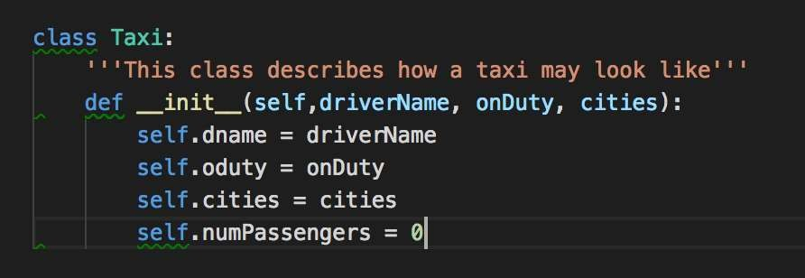

Example Class
CLASS NAME

Slide 73
The
init method
is a special method in Python classes,
init method is the constructor method for a class
is called when ever an object of the class is constructed.
init
The
init
Programmer makes a new object
init method is called
Behaviour within the
init method executes
myTaxi = Taxi(“Aleks”)
Self.taxiDriver = “Aleks”

Slide 74
Example Object - Taxi
DATA
DriverName
OnDuty
NumPassenger
Cities

Slide 75
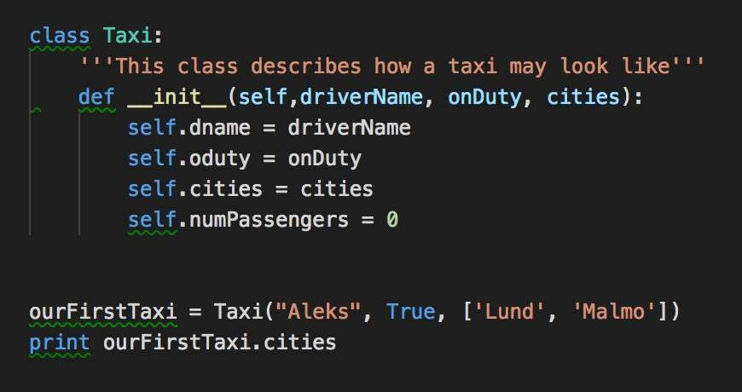
Creating an object from the class
From one class, you make objects (instances).

Slide 76
Object Creation Flow
To create a new object, use the class name

Slide 77
Object Creation Flow
To create a new object, use the class name
When you create a new object, the init method from the class is called with the parameters that were passed.

Slide 78
Object Creation Flow
The init method Is called

Slide 79
Example Object - Taxi
DATA
DriverName
OnDuty
NumPassenger
Cities
BEHAVIOR
PickUpPassenger
DropOffPassenger
SetDriverName
GetDriverName

Slide 80
Behavior of a class
classes/objects can have methods just like functions except that they have an extra self variable at the beginning.
An object method takes as the first parameter the object (self) and can accept any number of other parameters.

Slide 81
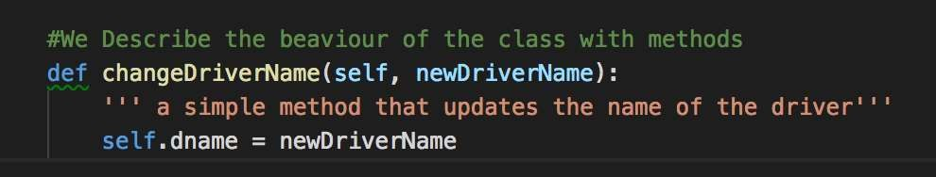
Example Object Method
This method changes the name of the taxi driver for the passed object (self).

Slide 82
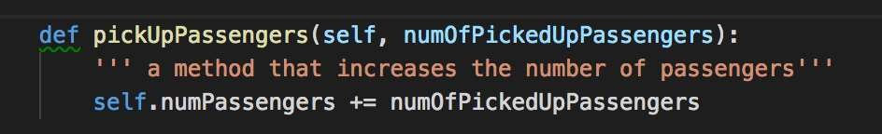
Another example of an object method

Slide 83
Exercise: Write a class that describes a Bus.
A bus is created with a number of seats, a color, and is driven by a bus driver that has a name. New passengers can get in the bus, and existing bus passengers can leave their seat and get of the bus. Number of buss passengers can’t be smaller than 0.
Instructions
Start by drawing a class diagram
Create a class for the bus in python
Create two objects of your class

Slide 84
Object vs. Class Variables
Most variables are object specific (for example, the variable number of passengers in a taxi is different for every taxi that we create).
Some variables are common to all objects (for example, if we want to count the number of taxis that we have in our company)
Class Taxi -> number_of_taxi_vehicles = 7
T1
T2
T7

Slide 85
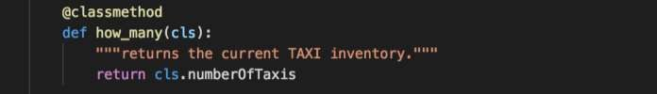
Accessing class variables
To access a class variable within a method, we use the @classmethod decorator, and pass the class to the method.

Slide 86
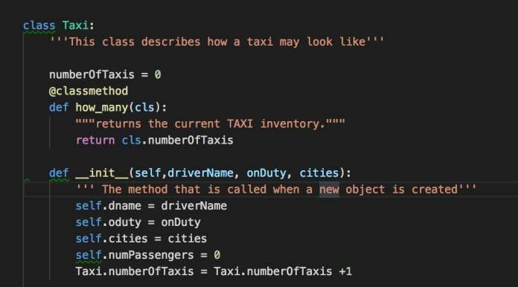
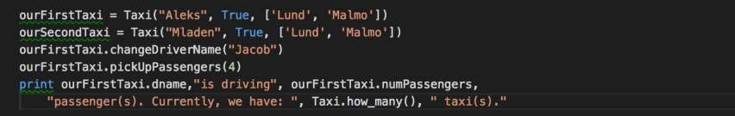
Example use of class variable

Slide 87
Exercise2: Update your class Bus.
As an owner of the bus company, I wish to keep track of the number of busses that people buy (create).
Instructions
Create a class variable
Increment a class variable on
init
Create a @classmethod to print its value

Slide 88

Exercise 3: Hippo ZOO
A local ZOO keeper wants to model his collection of Hippos in the Zoo.
Every hippo has a name and size (in kg). In the morning, a zoo keeper feeds the hypo so his weight increases. During the day the Hippo exercises, therefore his weight goes down.
A zoo keeper also needs a way to keep track how many Hippos he has in the ZOO.
Model this problem (1) with a Class diagram & (2) in Python OOP code.

Slide 89
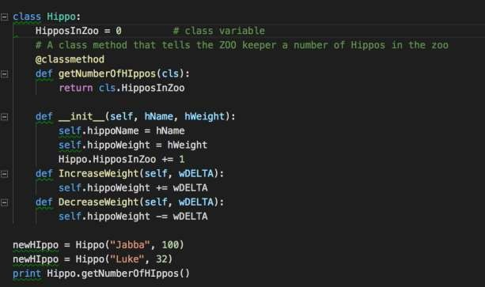
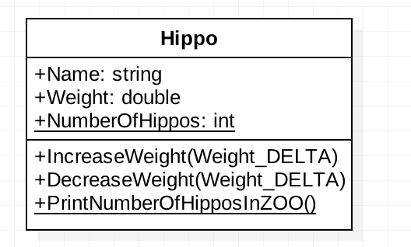
Example Solution

Slide 90
Takeaways
Today, we learned how to create simple classes and objects.
  A class is a blueprint for objects, and it contains attributes and behavior.
We added to our classes a number of:
  instance methods & instance variables (for example, color, size, etc.).
  class methods & class variables (for exmaple, a number of taxis).
We learned that new objects are created from a class through the
init method.

Slide 91
For Next time
In our next lecture, we will learn how to reuse the code that we have written today while describing other objects. We will learn about:
Inheritance. (TransportVehicle – Taxi)
Encapsulation (e.g. private functions)
Polymorphism (defining the same function for different types of objects)

Slide 92
Multithreading
Outline
1 Introduction
2 Thread States: Life Cycle of a Thread
3 threading.Thread Example
4 Thread Synchronization
5 Producer/Consumer Relationship without Thread Synchronization
6 Producer/Consumer Relationship with Thread Synchronization
7 Producer/Consumer Relationship: Module Queue
8 Producer/Consumer Relationship: The Circular Buffer
9 Semaphores
10 Events

Slide 93
Introduction
Threads often called “light-weight” process because operating systems generally require fewer resources to create and manage threads than to create and manage processes
Python’s threading capabilities depend on whether the operating system supports multithreading
Python’s threading module provides its multithreading capabilities

Slide 94
Thread States: Life Cycle of a Thread
Python interpreter controls all program threads
Python’s global interpreter lock (GIL) ensures that the interpreter runs only one thread at any given time
Thread is said to be in one of several thread states at any time
Python programs can define threads by inheriting from class threading.Thread and overriding its functionality

Slide 95
Thread States: Life Cycle of a Thread
Newly created thread begins its lifecycle in the born state
Invoking the thread’s start method places the thread in the ready state
The thread’s run method, which implements the tasks that the thread performs, obtains the GIL and enters the running state
Thread enters the dead state when its run method returns or terminates for any reason (e.g., an uncaught exception)

Slide 96
Thread States: Life Cycle of a Thread
A running thread that calls another thread’s join method forfeits the GIL and waits for the joined thread to die before proceeding
Thread enters the blocked state while it waits for a requested, unavailable resource (e.g. I/O device)
When a running thread calls function time.sleep, it releases the GIL and enters the sleeping state

Slide 97
Deadlock occurs when one or more threads wait forever for an event that cannot occur
In indefinite postponement, one or more threads is delayed for some unpredictably long time

Slide 98
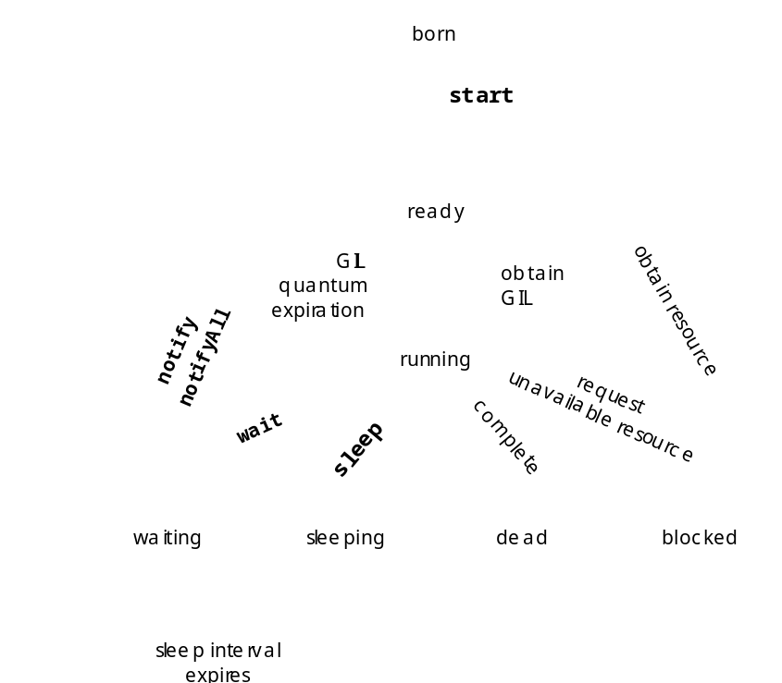
Thread States: Life Cycle of a Thread
Fig. State diagram showing the life cycle of a thread.

Slide 99
Thread States: Life Cycle of a Thread
Module threading provides ways for a program to obtain information about its threads, including their current states
  Function threading.currentThread returns reference to currently running Thread object
  Function threading.enumerate returns list of currently active Thread objects
  Function threading.activeCount returns length of list returned by threading.enumerate
  Method isAlive returns 1 if the Thread object’s start method bas been invoked and the Thread object is not dead
  Methods setName and getName allow programmer to set and get a Thread object’s name, respectively

Slide 100
threading.Thread example
Threads can be created by defining a class that derives from threading.Thread and instantiating objects of that class

Slide 101
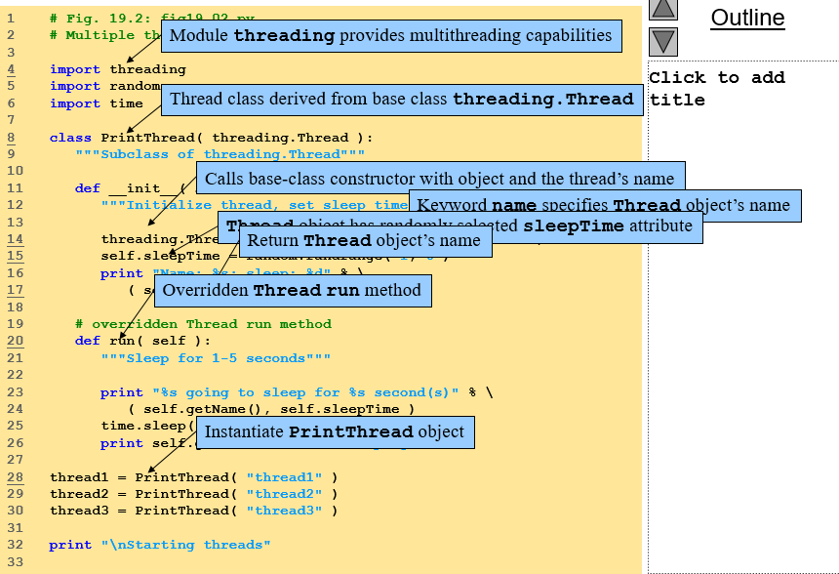

Slide 102
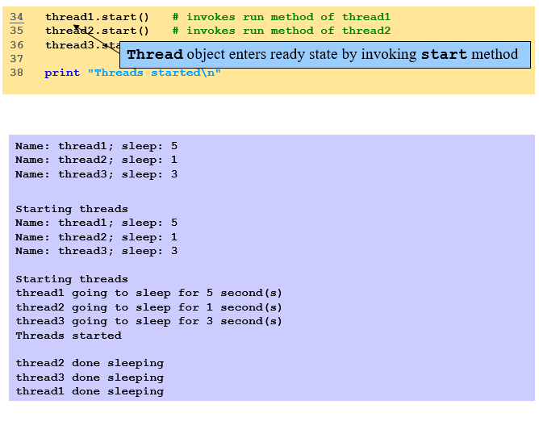

Slide 103
Thread Synchronization
Sections of code that access shared data are referred to as critical sections
Mutual exclusion or thread synchronization ensures a thread accessing the shared data excludes all other threads from doing so simultaneously
Module threading provides several thread-synchronization mechanisms (e.g., locks and condition variables)

Slide 104
Thread Synchronization
Class threading.RLock creates lock objects
  Method acquire causes lock to enter locked state
  Only one thread may acquire lock at a time so system places any other threads who attempt to acquire lock in blocked state
  When the thread that owns the lock invokes method release, the lock enters the unlocked state and blocked threads receive a notification so one can acquire the lock

Slide 105
Thread Synchronization
Condition variables monitor the state of an object or notify a thread when an event occurs
  Created with class threading.Condition
  Provides acquire and release method because condition variable contains underlying locks
  Method wait causes calling thread to release lock lock and block until it is awakened again
  Method notify wakes up one thread waiting on the condition variable
  Method notifyAll wakes up all waiting threads

Slide 106
Producer/Consumer Relationship without Thread Synchronization
Producer portion of application generates data
Consumer portion of application uses that data
Producer thread calls produce method to generate data and place it into a shared memory region called a buffer
Consumer thread calls consumer method to read data from the buffer

Slide 107
Producer/Consumer Relationship with Thread Synchronization
Producer and consumer can access shared memory cell with synchronization
  Ensures that the consumer consumes each value exactly once
  Ensures that consumer waits for producer to execute first

Slide 108
Producer/Consumer Relationship: Module Queue
Module Queue defines class Queue, which is a synchronized implementation of a queue
Queue constructor accepts optional argument maxsize
Consumer consumes value by calling Queue method get, which removes and returns item from the head of the queue
Producer produces value by calling Queue method put, which inserts item at tail of queue

Slide 109
Producer/Consumer Relationship: The Circular Buffer
Circular buffer provides extra buffers into which the producer can place values and from which the consumer can retrieve those values

Slide 110
Semaphores
Semaphore: variable that controls access to common resource or critical section
Maintains a counter that specifies number of threads that can use the resource or enter the critical section simultaneously
Counter decremented each time a thread acquires the semaphore
When counter reaches zero, semaphore blocks other threads from accessing semaphore until it has been released by another thread

Slide 111
Events
Module threading defines class Event, which is useful for thread communication
Event objects have an internal, true or false flag
One or more threads call the Event object’s wait method to block until the event occurs
When the event occurs, the blocked thread or threads are awakened in the order that they arrived and resume execution

